Slide 1


Slide 2
Vue.js Introduction
Client/Server Architecture
JavaScript Quick review
JSON
Git
What is Vue.js
Environment Setup
Vue.js reference

Slide 3
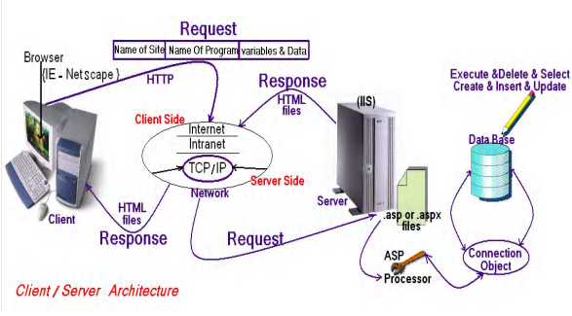
Client/Server Architecture

Slide 4
Web programming language
Web programming language
Server Side
Java Script
client side
PHP
ASP.Net
HTML
CSS

Slide 5
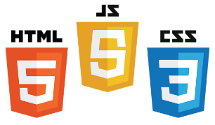

Core Components of Web Applications
UI (Front End (DOM, Framework))
Request Layer (Web API)
Back End (Database, Logic)
Server
Client
API
Front End
Database
Browser
Internet
Logic
JSON
Media Cache

Slide 6

client side Cross-platform
client side Cross-platform

Slide 7

client side Cross-platform
client side Cross-platform

Slide 8
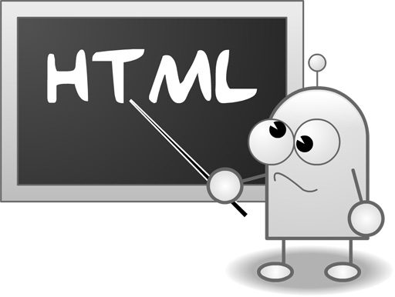
HTML Hyper Text Markup Language

Slide 9
HTML Hyper Text Markup Language
What is HTML?
HTML is a language for describing web pages.
HTML stands for Hyper Text Markup Language
HTML is a markup language
A markup language is a set of markup tags
The tags describe document content
HTML documents contain HTML tags and plain text
HTML documents are also called web pages

Slide 10
HTML Versions
Version | Year
HTML | 1991
HTML+ | 1993
HTML 2.0 | 1995
HTML 3.2 | 1997
HTML 4.01 | 1999
XHTML 1.0 | 2000
HTML5 | 2012
XHTML5 | 2013

Slide 11
CSS : Cascading Style Sheets
What is CSS?
CSS stands for Cascading Style Sheets
Styles define how to display HTML , XML elements
Styles were added to HTML 4.0 to solve a problem
Combined with JavaScript and VBScript
Separate format and content
External Style Sheets can save a lot of work

Slide 12
JS:(JavaScript)
JavaScript was developed in 10 days in May 1995 by Brendan Eich, then working at Netscape, as the HTML scripting language for their browser Navigator 2 (more about history). Brendan Eich said (at the O'Reilly Fluent conference in San Francisco in April 2015): "I did JavaScript in such a hurry, I never dreamed it would become the assembly language for the Web".
JavaScript is a dynamic functional object-oriented programming language that can be used for

Slide 13
JS:(JavaScript)
Enriching a web page by
generating browser-specific HTML content or CSS styling,
inserting dynamic HTML content,
producing special audio-visual effects (animations).
Enriching a web user interface by
implementing advanced user interface components,
validating user input on the client side,
automatically pre-filling certain form fields.
Implementing a front-end web application with local or remote data storage, as described in the book Building Front-End Web Apps with Plain JavaScript.
Implementing a front-end component for a distributed web application with remote data storage managed by a back-end component, which is a server-side program that is traditionally written in a server-side language such as PHP, Java or C#, but can nowadays also be written in JavaScript with NodeJS.
Implementing a complete distributed web application where both the front-end and the back-end components are JavaScript programs.

Slide 14

DOM (Document Object Model)
Document Object Model makes every addressable item in a web application an Object that can be manipulated for color, transparency, position, sound and behaviors.
Every HTML Tag is a DOM object
CSS
DOM
JavaScript
HTML

Slide 15
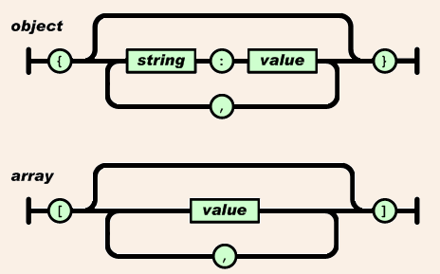
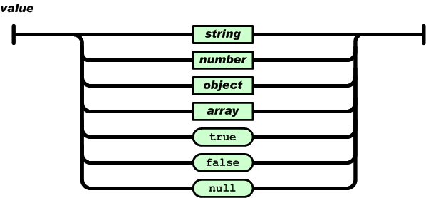
JSON (JavaScript Object Notation)

Slide 16
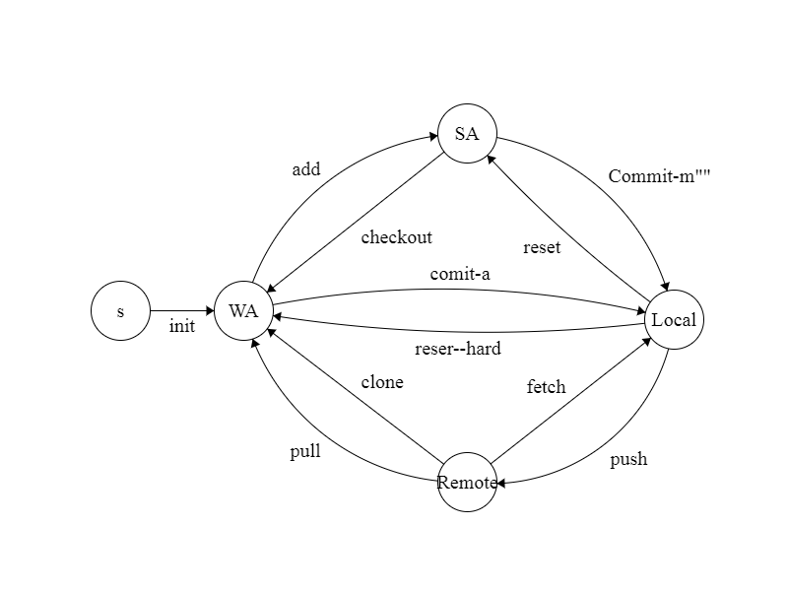
Git distributed version control system

Slide 17

best JS frameworks available in the markets for web application development.
AngularJS.
React.
Ember.js.
Vue.js.
Backbone.js.
Mithril.js.
Polymer.js.
Node.js.

Slide 18
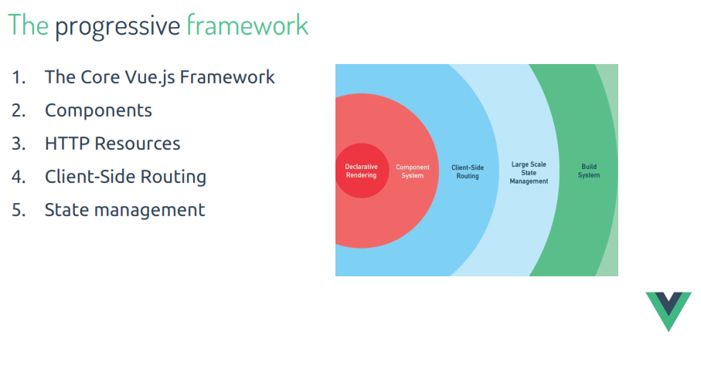
Why Vue

Slide 19
Features
Lightweight
Reusable Components
Directives
Event Handling
Routing

Slide 20
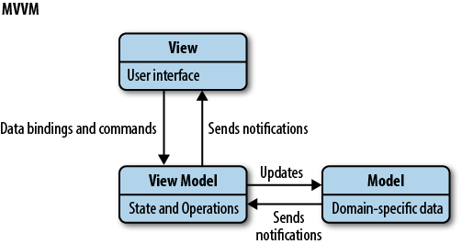
Vue Course layout
Vue is MVVM pattern

Slide 21
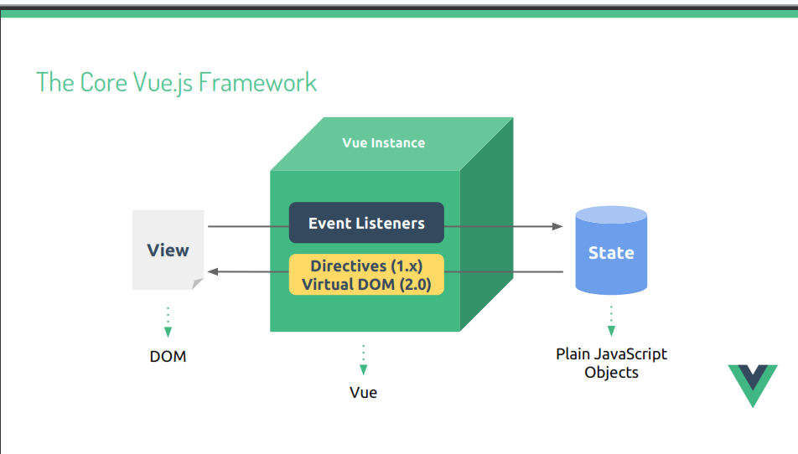
Vue Course layout

Slide 22
Vue.js Course PreRequisite
Requirements necessary
HTML
JS
Preferred
CSS
Git

Slide 23



Environment Setup
Required Programs
Browser
Optional Programs
VScode IDE Setup
GitHub Version Control
vue devtools

Slide 24
Environment Setup
visual studio code IDE extensions
Vue VS Code Extension Pack
Git
https://code.visualstudio.com/

Slide 25

Vue.js Installation
CDN
<script src="https://cdn.jsdelivr.net/npm/vue@2.5.22/dist/vue.js"></script>
NPM
npm install vue

Slide 26
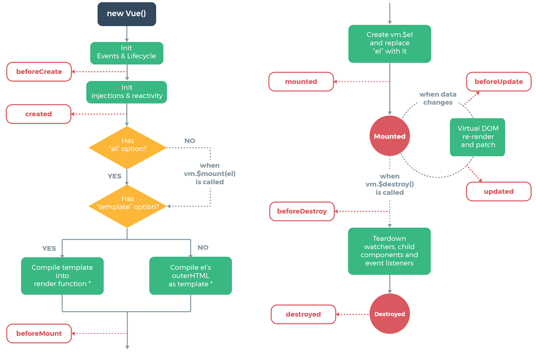
Architecture

Slide 27
Vuejs reference
https://vuejs.org/v2/guide/

